Slide 1
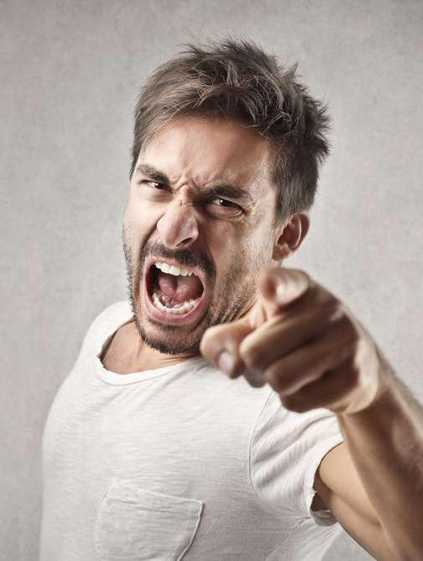

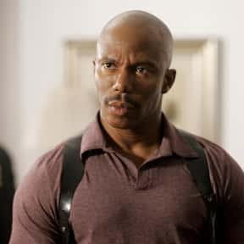
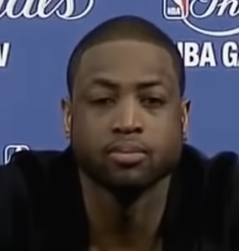


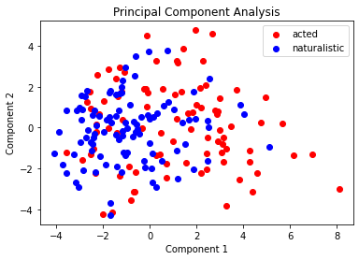
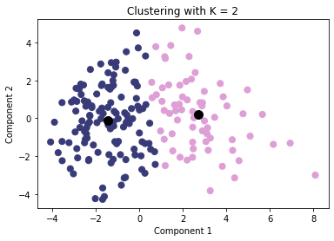
IDENTIFYING DIFFERENT FACES OF ANGER
BACKGROUND
Motivation: Due to the diversity in culture among humans, the way anger is displayed varies in these different cultures.
Purpose: Use machine learning algorithms to create a model that accurately differentiates different levels of anger using social signals.
Objective: Provide a non-biased method of identifying different levels of anger regardless of culture.
CLASSIFICATION
METHOD
Principal component analysis (1) was done to reduce the number of dimensionality by taking in multiple action units as input.
K-Means clustering model (2) was used to determine the type of anger.
5 fold cross validation will be used to evaluate the efficacy of the model.
>:O
:/
ACTED
NATURALISTIC
Loud Anger [1]
Subtle Anger [2]
Loud Anger [3]
Subtle Anger [4]
DISCUSSION
Observation 1: Our silhouette score is low due to the fact that we have used a small dataset to compute our results.
Observation 2: Our low explained variances for the components explained by the result of using all the action units given by OpenFace as input for PCA.
Future Objective:
Maximize silhouette score by gathering more images consisting of diverse representation of anger
Maximize explained variances by optimizing the combination of different action units
Find more clusters in order to obtain more levels of anger.
>:(
DATASET
We created the dataset by taking screenshots of people varying types of anger from various places on the internet and pre existing datasets.
The dataset was annotated subjectively through free annotation and objectively through running the images we collected through OpenFace to obtain the action unit data.
>:/
(1) Principal Component Analysis of acted and naturalistic data
(2) K-Means clustering of acted and naturalistic data
RESULTS
Explained variance for Components 1 and 2 = (0.160, 0.097)
Optimal value of K clusters = 2
Optimal Silhouette Score = 0.417
Cluster 1 (Left) = Subtle Anger
Cluster 2 (Right) = Loud Anger
References
https://www.cbtandcounsellingkent.co.uk/how-emotionally-intelligent-people-express-anger-frustration/
https://www.imdb.com/name/nm0454701/
https://www.youtube.com/shorts/7jIy1-zkmkI
https://www.youtube.com/watch?v=8xsotflQGP4

Slide 2
What to include:
Goal of project clearly conveyed
Analysis of collected dataset, Describe collection method. Include interesting findings. Figures or examples of data collected/annotated in this project.
Method, Clearly describe approach
Results, Initial results, in a format that effectively conveys result, e.g. graph, figure
Figures and visualization, Overall impact of figures and visual information presented.
Easy to link figures to any related text.
Captions.
Overall style
Catchy title.
Effective layout and headings.
No big walls of text.
Font and font size is readable.
Consistent color scheme.
References and citations.

Slide 3
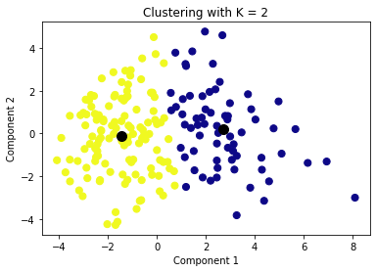
IDENTIFYING ANGER BASED ON SOCIAL SIGNALS
MOTIVATION
Due to the diversity in culture among humans, the way anger is displayed varies in these different cultures. So the purpose of this project is to use machine learning algorithms to create a model that accurately differentiates different levels of anger using social signals. This will provide a non-biased method of identifying different levels of anger regardless of culture.
CLASSIFICATION
METHOD
Principal component analysis (see (1)) was done to reduce the number of dimensionality by taking in multiple action units as input. K-Means clustering model (see (2)) was used to determine the type of anger. 5 fold cross validation will be used to evaluate the efficacy of the model.
ACTED
NATURALISTIC
Loud Anger [1]
Subtle Anger [2]
Loud Anger
Subtle Anger [4]
Loud Anger [3]
DISCUSSION
From our results, it is observed that our Silhouette score is low. This is due to the fact that we have collected a small dataset containing 200 images used for computing our results. We also observed a low explained variance for our components as a result of using all the action units given by OpenFace as input. We plan to optimize the combination of different action units and gather more images consisting of diverse representation of anger in order to maximize our silhouette score and explained variances as well as find more clusters in order to obtain more levels of anger.
DATASET
We created the dataset by taking screenshots of people varying types of anger from various places on the internet and pre existing datasets. The dataset was annotated subjectively through free annotation and objectively through running the images we collected through OpenFace to obtain the action unit data.
FIG (1). Principal Component Analysis of acted and naturalistic data
FIG (2). K-Means clustering of acted and naturalistic data
RESULTS
Explained variance for Component 1: 0.160
Explained variance for Component 2: 0.097
Optimal value of K clusters: 2
Optimal Silhouette Score: 0.417
References
https://www.cbtandcounsellingkent.co.uk/how-emotionally-intelligent-people-express-anger-frustration/
https://www.imdb.com/name/nm0454701/
https://www.youtube.com/shorts/7jIy1-zkmkI
https://www.youtube.com/watch?v=8xsotflQGP4

